Slide 1
Household
Carbon
Footprint
of
Qatar
Concept Note and Methodology

Slide 2
What is
Carbon Footprint?
Carbon footprint, amount of carbon dioxide (CO₂) emissions emitted from all the activities of a person or family (company, country, etc.). It includes direct emissions, such as those that result from fossil-fuel combustion in manufacturing, cooling, and transportation, as well as emissions required to produce the electricity associated with goods and services consumed.

Slide 3
About this Survey
The survey is anonymous
For students above age 15 years
One survey for each household
The survey will run from February 1 – March 1 2020
Parents/Teachers guidance required
Number of questions - 25

Slide 4
What you need
Smart Phone
Weighing Scale
Grocery Bill
Kahramaa Bills

Slide 5
Sociodemographic
questions

Slide 6
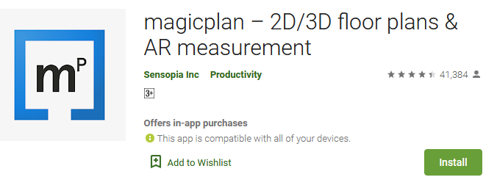
Measuring Floor area (m2)

Slide 7
Number of kilometres traveled by each car for the surveyed month
Amount of fuel used by each car
Number of cars in home
Istimara – has all the details about the vehicle model
Transport
Emissions

Slide 8
Fuel
consumption
for cooking
Number of cylinders used per month (6kg and 12 kg available in the market)

Slide 9
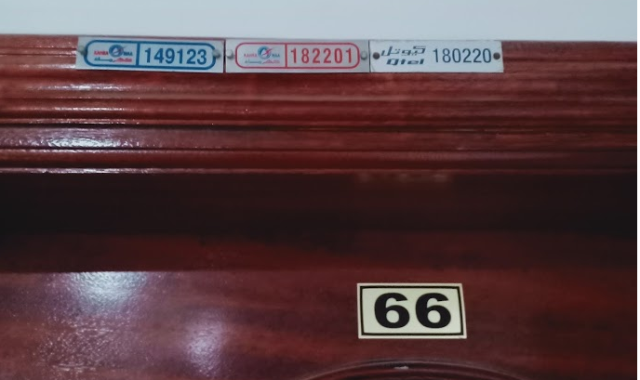
Electricity and Water Statistics
What you need – Smart Phone, Electricity Number and CR Number for non-Qataris or ID Number for Qataris
Where to get CR Number – Ask your landlord or building manager
On top of your door, you will find the Kahramaa electricity number – The green circle highlighted is your meter number

Slide 10
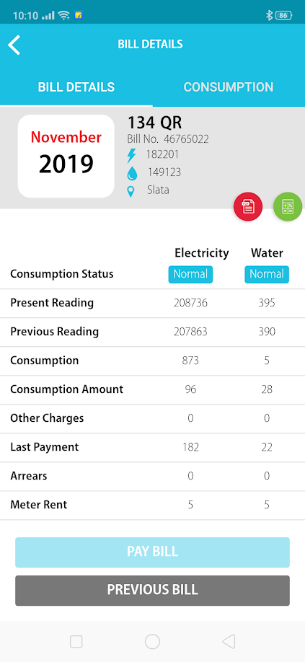
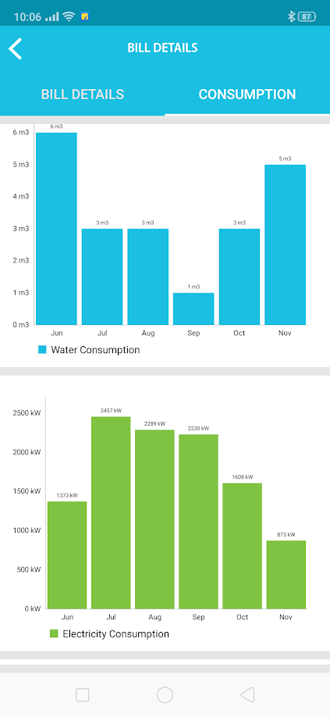
Current Month Bill
Click Consumption to get old month bills
You will see six months consumption for electricity and water

Slide 11
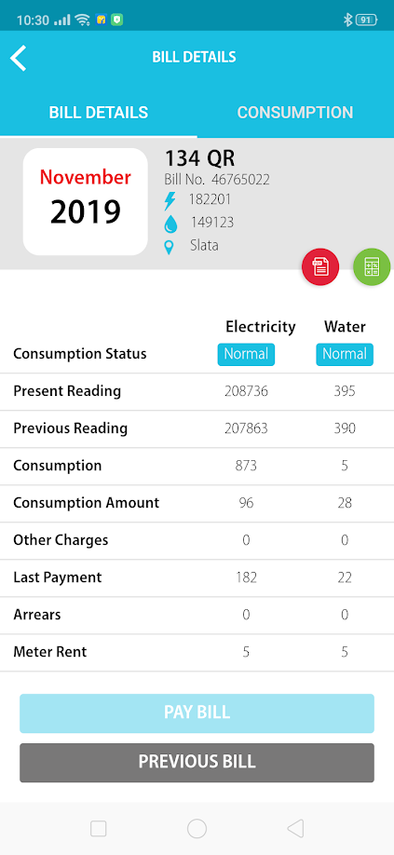
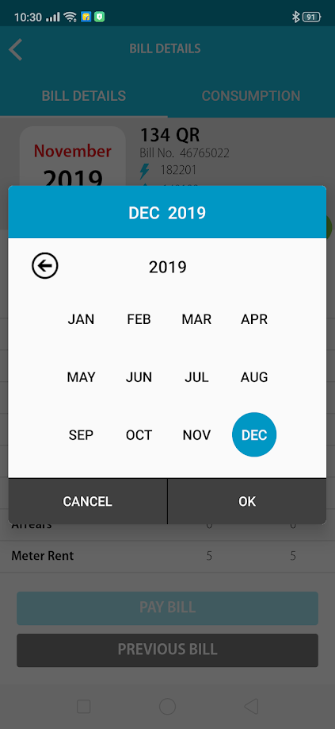
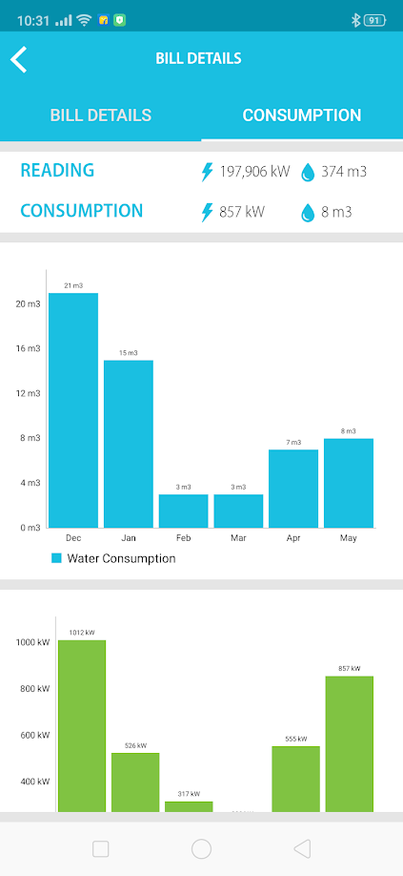
Checking previous month consumption
Click Previous Bill
Click the month you want to check
You will see previous month consumption data

Slide 12
Waste
Statistics
Organic Waste – Vegetables, fruits, leftover food, grass, etc.
Plastic waste – bottles (water, milk, etc.), plastic covers, wrappings, etc.
Paper waste – News papers, carton boxes, note books, papers, etc.
Other waste – electronic, textiles, etc.

Slide 13
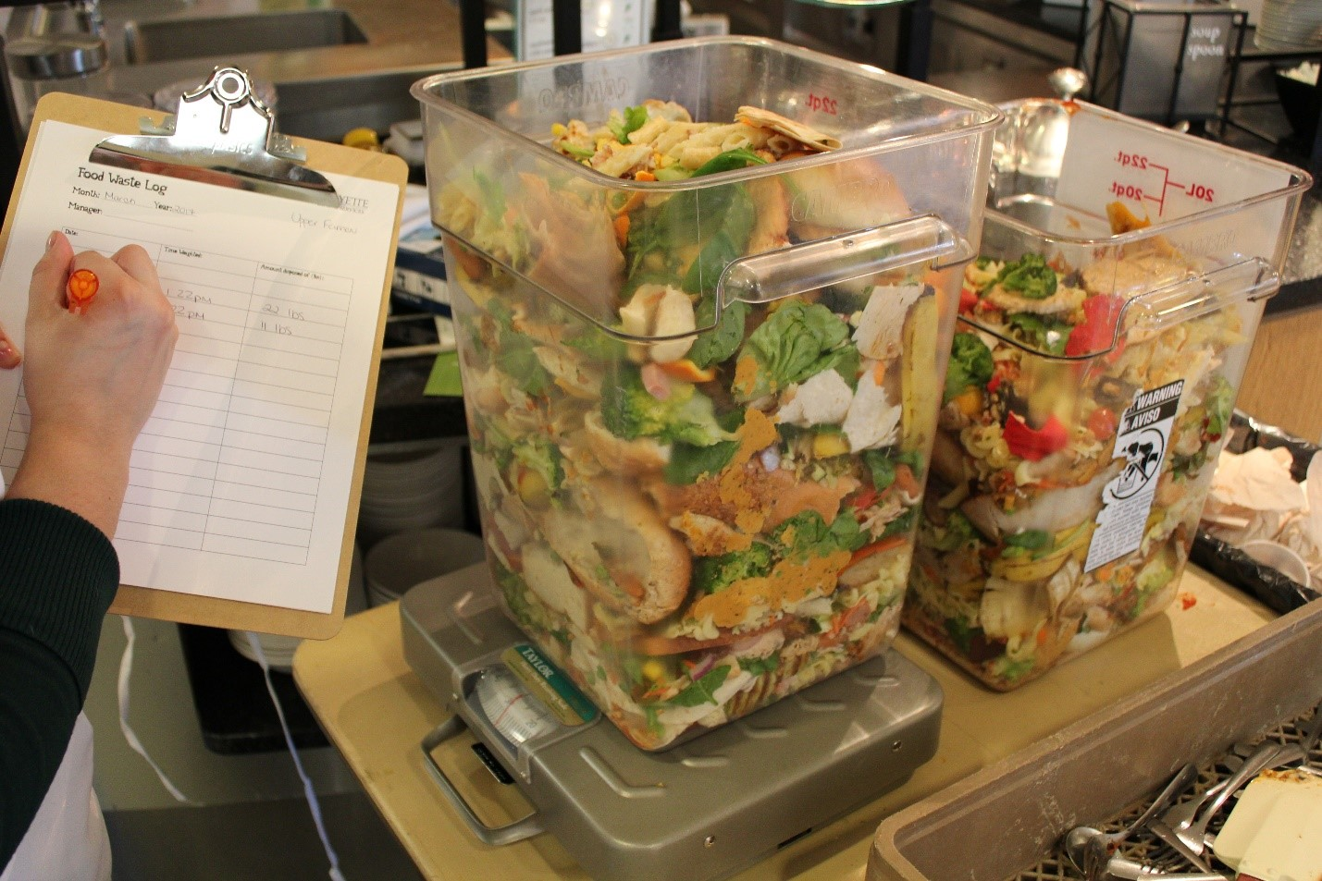
Weigh your waste before throwing

Slide 14
Cereals, pulses, and other dry products
Meat and poultry (chicken, lamb, beef)
Grocery bill
Fish and seafood
Dairy products (milk, cheese, etc.)
Vegetables
Fruits

Slide 15
Thank You

